Slide 1


Mixed Criticality Systems: A History of Misconceptions?
Borislav Nikolić
TU Braunschweig, Germany

Slide 2
Outline
Introduction to Mixed Criticality Systems
Safety standards
Industrial view
Academic view
Challenges

Slide 3
Outline
Introduction to Mixed Criticality Systems
Safety standards
Industrial view
Academic view
Challenges

Slide 4

Introduction to Mixed Criticality Systems
Notes:
- Mixed Criticality Systems are not a novelty, but a well known topic in both academia and industry.
- Real-time community has more or less a unified, and to an extent limited view of what Mixed Criticality Systems are.
- However, that does not conform to the industrial view (as will be discussed later)
- Therefore, we first revisit the definition: What is the Mixed Criticality System?

Slide 5
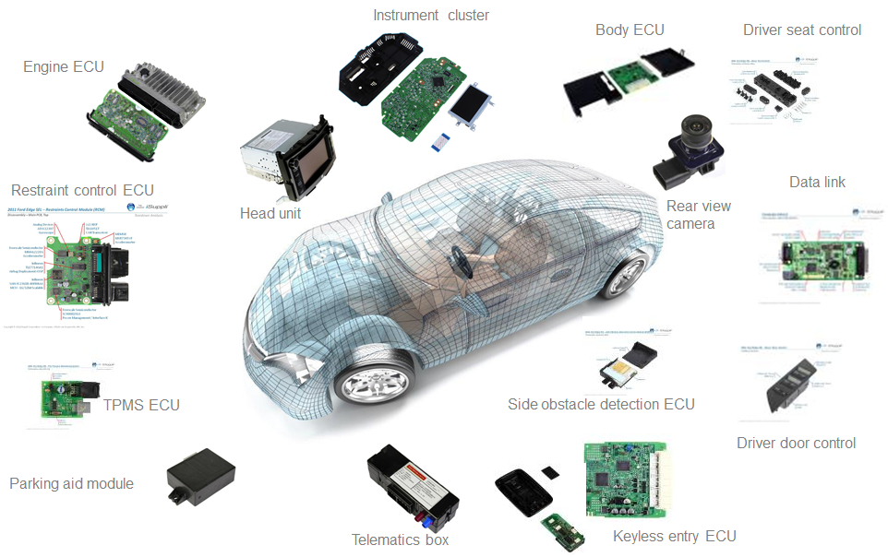
What is (and is not) a Mixed Criticality System?
Notes:
MCS = Embedded system in which application functions of different criticality share computation/communication resources.
But what criticality refers to in the first place?

Slide 6
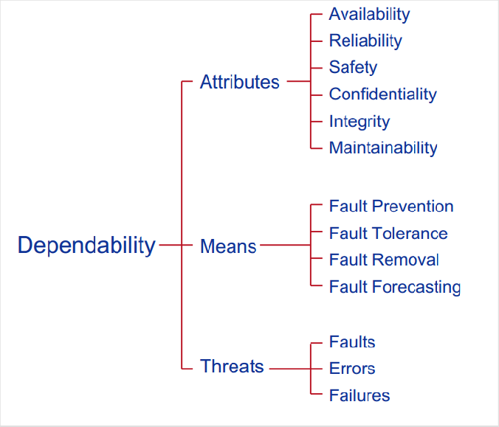
Criticality Refers to?
Criticality usually refers to functional safety
Notes:
Criticality = All forms of dependability, but the term is mostly used for functional safety.

Slide 7
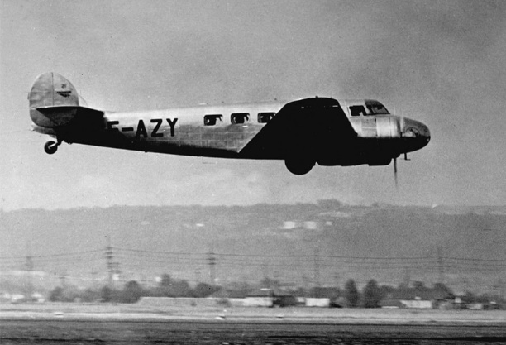
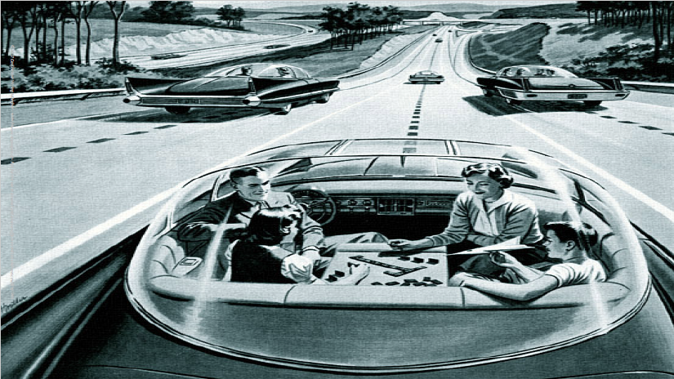

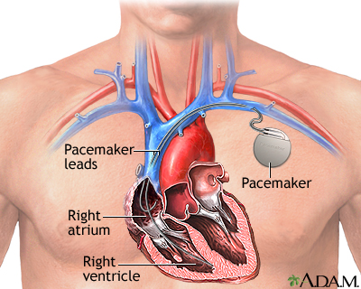

Requirements of Mixed Criticality Systems
Functional safety
High performance

Slide 8
Outline
Introduction to Mixed Criticality Systems
Safety standards
Industrial view
Academic view
Challenges

Slide 9
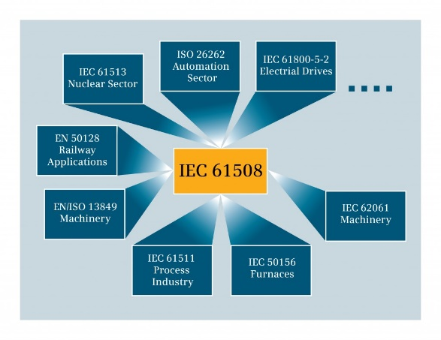
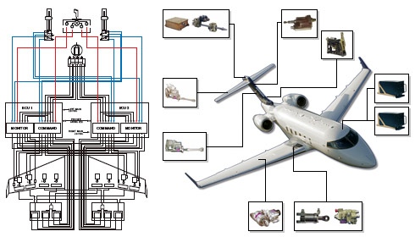
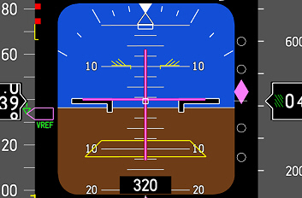
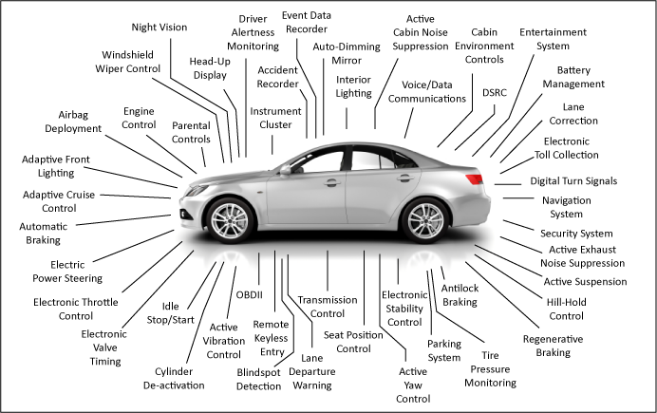
Safety standards
Relevant standards:
IEC 61508
DO 254
DO 178C
ISO 26262

Slide 10
How are criticalities derived?
Usually via a failure modes and effect criticality analysis (FMECA)
Identify the function and failure modes
Analyse failure causes and effects
Assign severities to failure modes
Identify the existing compensating provisions
Assign criticality categories and recommendations
Notes:
FMECA first in space (even Apollo missions) and military, and other domains accepted
The key parameters to be taken into account are: failure probability and severity
FMECA can be perceived as an extension of FMEA
Another option is FTA

Slide 11
Criticality qualification and quantification?
In ISO 26262 used ASIL levels (Automotive-SIL)
SIL used in IEC 61508, DAL in DO 178C
ISO 26262 can be seen as IEC 61508 extension, but incomparable
Relevant parameters:
Exposure | E0 | E1 | E2 | E3 | E4
 | Incredible | Very low probability | Low probability | Moderate probability | High probability
Severity | S0 | S1 | S2 | S3
 | No injuries | Light and moderate injuries | Severe and life-threatening injuries (survival probable) | Life-threatening injuries (survival uncertain), fatal injuries
Controllability | C0 | C1 | C2 | C3
 | Controllable in general | Simply controllable | Normally controllable | Difficult to control or uncontrollable
Notes:
ASIL not to be compared with SIL (ISO 26262 vs IEC 61508 not comparable)
61508 focus on safety functions (measures the reliability of the safety functions) SIL1 – SIL4
26262 focus on safety goals (based on the violation of safety goal) ASIL A – ASIL D

Slide 12
Criticality qualification and quantification?
Severity | Exposure | Controlability
 |  | C1 | C2 | C3
S1 | E1 | QM | QM | QM
 | E2 | QM | QM | QM
 | E3 | QM | QM | A
 | E4 | QM | A | B
S2 | E1 | QM | QM | QM
 | E2 | QM | QM | A
 | E3 | QM | A | B
 | E4 | A | B | C
S3 | E1 | QM | QM | A
 | E2 | QM | A | B
 | E3 | A | B | C
 | E4 | B | C | D
Notes:
Quantification is left for interpretation, but a recommendation is that ASIL D = 1 fault / 10^9 hours

Slide 13
ASIL inheritance and decomposition
Derived ASIL level corresponds to the system function
Then, HW and SW components which realise it inherit its level
In case of sharing → inherit the highest ASIL
Components’ constraints can limit the maximum achievable ASIL
For example, the physical properties of the link lower than ASIL D
One way to solve this problem is ASIL decomposition
ASIL D
ASIL D
ASIL D
ASIL C (D)
ASIL A (D)
ASIL B (D)
ASIL B (D)
ASIL D
QM (D)

Slide 14
ASIL decomposition
Decomposition requirements:
Both elements must address the same safety goal
Each element must take on the same safe state
Preferably diverse (heterogeneous) and independent
Already existed in IEC 61508
Can be used to reduce the production costs
It is a qualitative concept, more addressing systematic issues (architecture) than random errors (hardware reliability)
Is it a way of introducing redundancy?
Notes:
- Not always all decomposition procedures possible, due to project-specific constraints (e.g. legacy components)
Additionally, diversification is expensive and often not an option (competitiveness)
Usually asymmetrical decomposition via more and less reliable components

Slide 15
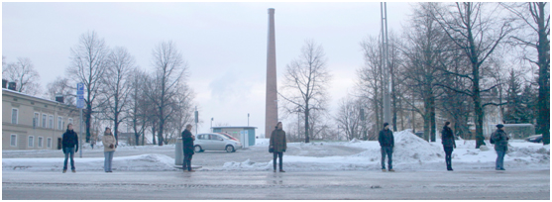
Key requirement: “sufficient independence”
IEC 61508: “sufficient independence”
ISO 26262: “freedom from interference”
Designing everything for highest SIL far too costly or even impossible
“Sufficient independence” / “freedom from interference” = only viable approach
ARINC 653 defines time and memory space partitioning and uses TDMA
ISO 26262 allows static priority scheduling (without inversion effects)
both temporally and spatially
for functions of different criticalities
Notes:
Also called separation or segregation mechanism
OSEK/VDX and AUTOSAR utilise SP scheduling in ISO 26262
Often comes with a large performance loss, at least for the less critical functions
TDMA was the first mechanism to start paying the price

Slide 16
Outline
Introduction to Mixed Criticality Systems
Safety standards
Industrial view
Academic view
Challenges

Slide 17
Industrial view of Mixed Criticality Systems

Slide 18
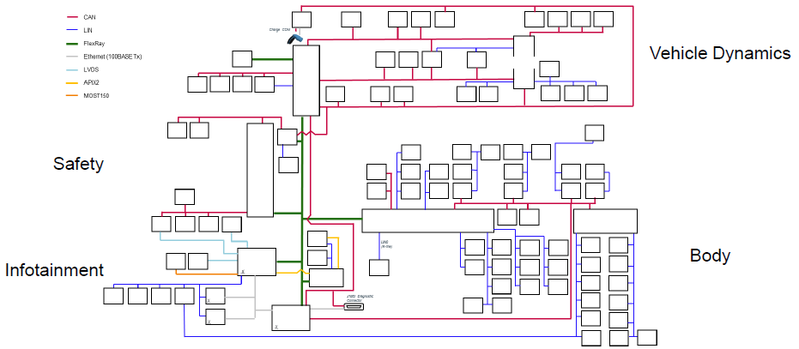
Industrial view of Mixed Criticality Systems
Mix of legacy busses connected via Ethernet as a backbone

Slide 19
Why multiple technologies?
Legacy busses (CAN, LIN, FlexRay) are cheap and sufficient in sub-domains
Increasing requirements for higher bandwidth are met with Ethernet backbone
Such design requires gateways (additional delays)
Idea to move to the mono-technological domain in 2020s
Ethernet the most suitable technology
It would reduce time to market
Gateways become obsolete
Still, more than half of OEMs in Germany think this is unrealistic

Slide 20

Market demands
In such heterogeneous environment ever-increasing demands:
More processing power on cores
More bandwidth
Better connectivity 5G (car – to car, car – to internet)
Power efficiency
Competitiveness
Security
Autonomy

Slide 21
Development trend: Service-oriented architecture
Cars are already perceived as “software on wheels”
This means heavy reusability of both existing HW and SW
Sharing sensor values by multiple functionalities (of different criticalities):
Wheel sensors: transmission (HI) and navigation (LO)
Breaks: antilock breaking (HI), cruise control (LO)
High-performance requirements (ADAS and AD):
Multiprocessors for reliable object recognition, and decision making based on high-resolution camera, radar, lidar. High safety-critical traffic volume.
Increasing ASIL
Similar to avionics (automated flight management requires high performance)
Notes:
- Usage of multiprocessors inevitable, but bring lots of overhead.
- Current ADAS functions are usually QM, i.e. the responsibility of the driver
- Will change with Autonomous driving to probably ASIL D
Reaching timing predictability for these systems is becoming increasingly complex
Similar in avionics where automated flight management

Slide 22
Requirements of Mixed Criticality Systems
Functional safety
High performance

Slide 23
Viable strategies for mixed criticality (1/2)
Efficient mechanisms to provide and demonstrate sufficient independence are necessary
Kernels and schedulers (e.g. separation kernels)
To enforce spatial and temporal separation among functionalities or partitions
Some examples: PikeOS implementing ARINC 653, QNX Neutrino, QUEST-V, CompSOC
Separation kernels usually implemented via time-triggered schedulers (but fixed priority scheduling also possible with monitoring exec. times)
Example: AUTOSAR (execution budget, lock budget, time frame)
Resource managers and partialisation mechanisms always have the highest priority
Notes:
PikeOS implementing ARINC 653 provides paravirtualisation to RTOS
QNX Neutrino certified separating microkernel for automotive
QUEST-V partitions cores into sandboxes with different priorities
CompSOC provides virtualization for systems-on-chip
AUTOSAR uses execution time protection to guarantee upper-bound execution (called execution budget)
Similarly, lock budget exists for locks
Interval time protection for frequency of execution (time frame is the term between two releases)

Slide 24
Viable strategies for mixed criticality (2/2)
Efficient mechanisms to provide and demonstrate sufficient independence are necessary
Mechanisms to detect timing faults and control them
Monitors to control/manage the criticality of functions
Overhead: independence between monitors and functions
Existing monitoring methods for AUTOSAR (Neukirchner et al.):
Memory protection, detection of timing faults and containment, admission control, reconfiguration
Similar approaches for IMA (Hill and Lake)
Monitoring and mode change with Ada (Baruah and Burns)
Notes:
- Monitors can prevent propagation of failures

Slide 25
Outline
Introduction to Mixed Criticality Systems
Safety standards
Industrial view
Academic view
Challenges

Slide 26
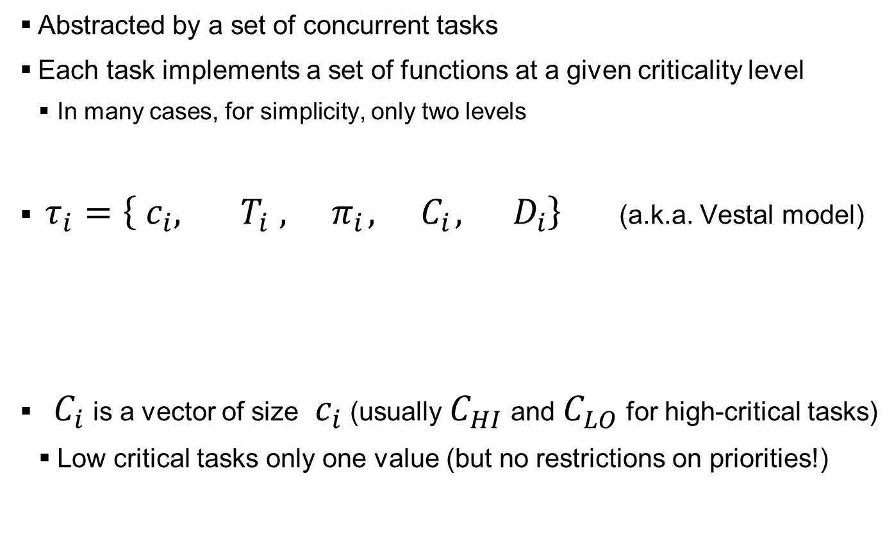
Academic view of Mixed Criticality Systems
Abstracted by a set of concurrent tasks
Each task implements a set of functions at a given criticality level
In many cases, for simplicity, only two levels
$τ_{i}=\left\{{ c}_{i}, { T}_{i},{ π}_{i},{ C}_{i},{ D}_{i}\right\}$ (a.k.a. Vestal model)
${ C}_{i}$ is a vector of size ${ c}_{i}$ (usually $C_{HI}$ and $C_{LO}$ for high-critical tasks)
Low critical tasks only one value (but no restrictions on priorities!)
task
criticality
level
period
priority
WCET
deadline

Slide 27
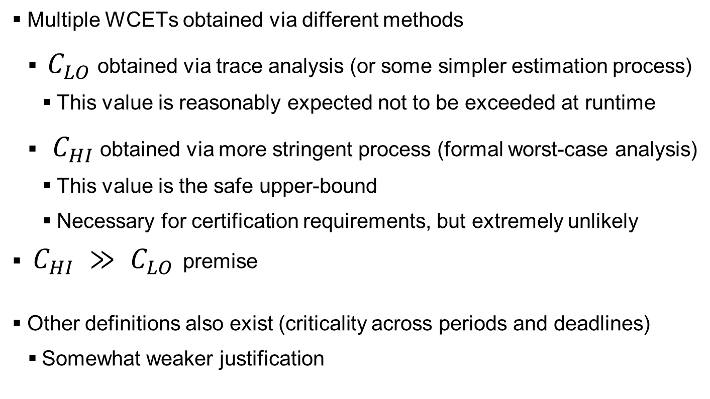
Model justification
Multiple WCETs obtained via different methods
$C_{LO}$ obtained via trace analysis (or some simpler estimation process)
This value is reasonably expected not to be exceeded at runtime
$C_{HI}$ obtained via more stringent process (formal worst-case analysis)
This value is the safe upper-bound
Necessary for certification requirements, but extremely unlikely
$C_{HI} ≫ C_{LO}$ premise
Other definitions also exist (criticality across periods and deadlines)
Somewhat weaker justification
Notes:
C_HI can be very unlikely to occur at runtime or even impossible (pessimistic)

Slide 28
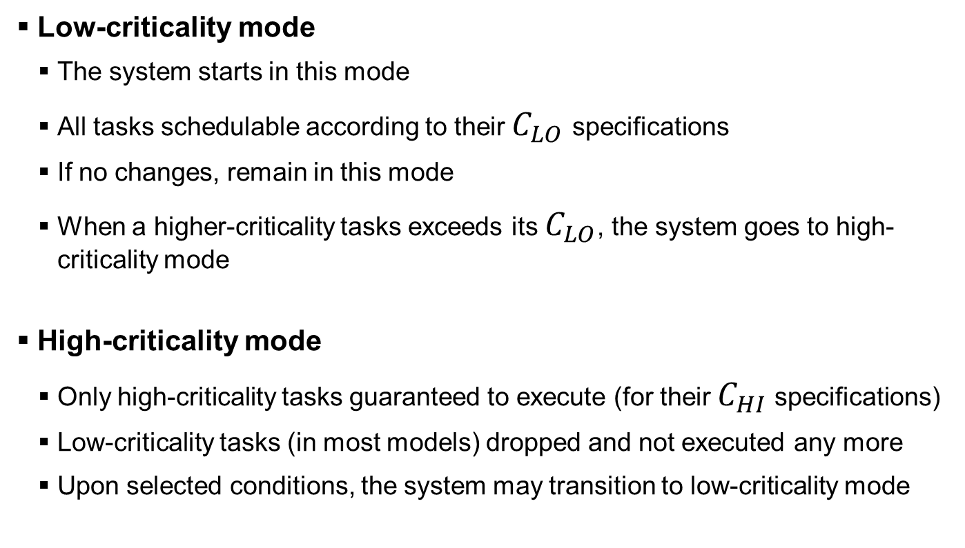
Model explained
Low-criticality mode
The system starts in this mode
All tasks schedulable according to their $C_{LO}$ specifications
If no changes, remain in this mode
When a higher-criticality tasks exceeds its $C_{LO}$, the system goes to high-criticality mode
High-criticality mode
Only high-criticality tasks guaranteed to execute (for their $C_{HI}$ specifications)
Low-criticality tasks (in most models) dropped and not executed any more
Upon selected conditions, the system may transition to low-criticality mode

Slide 29
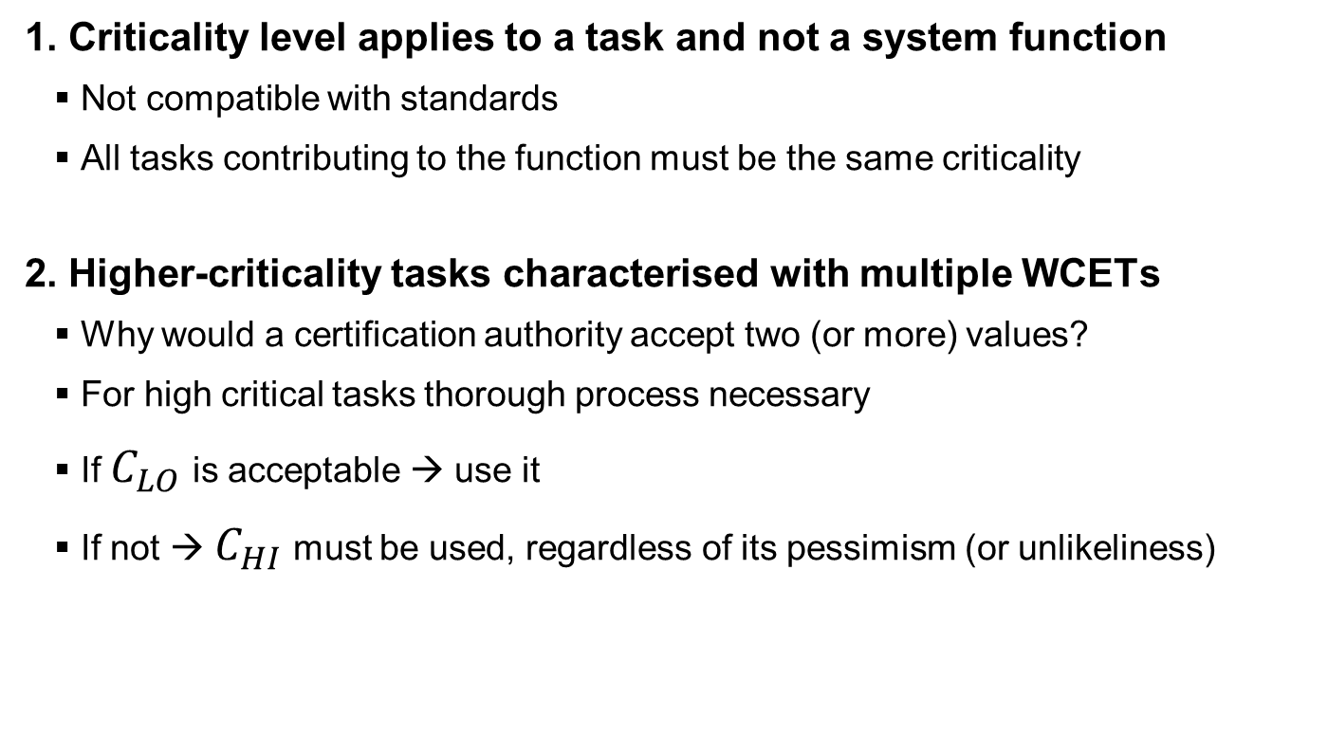
Fundamental assumptions and their limitations
1. Criticality level applies to a task and not a system function
Not compatible with standards
All tasks contributing to the function must be the same criticality
2. Higher-criticality tasks characterised with multiple WCETs
Why would a certification authority accept two (or more) values?
For high critical tasks thorough process necessary
If $C_{LO}$ is acceptable → use it
If not → $C_{HI}$ must be used, regardless of its pessimism (or unlikeliness)

Slide 30
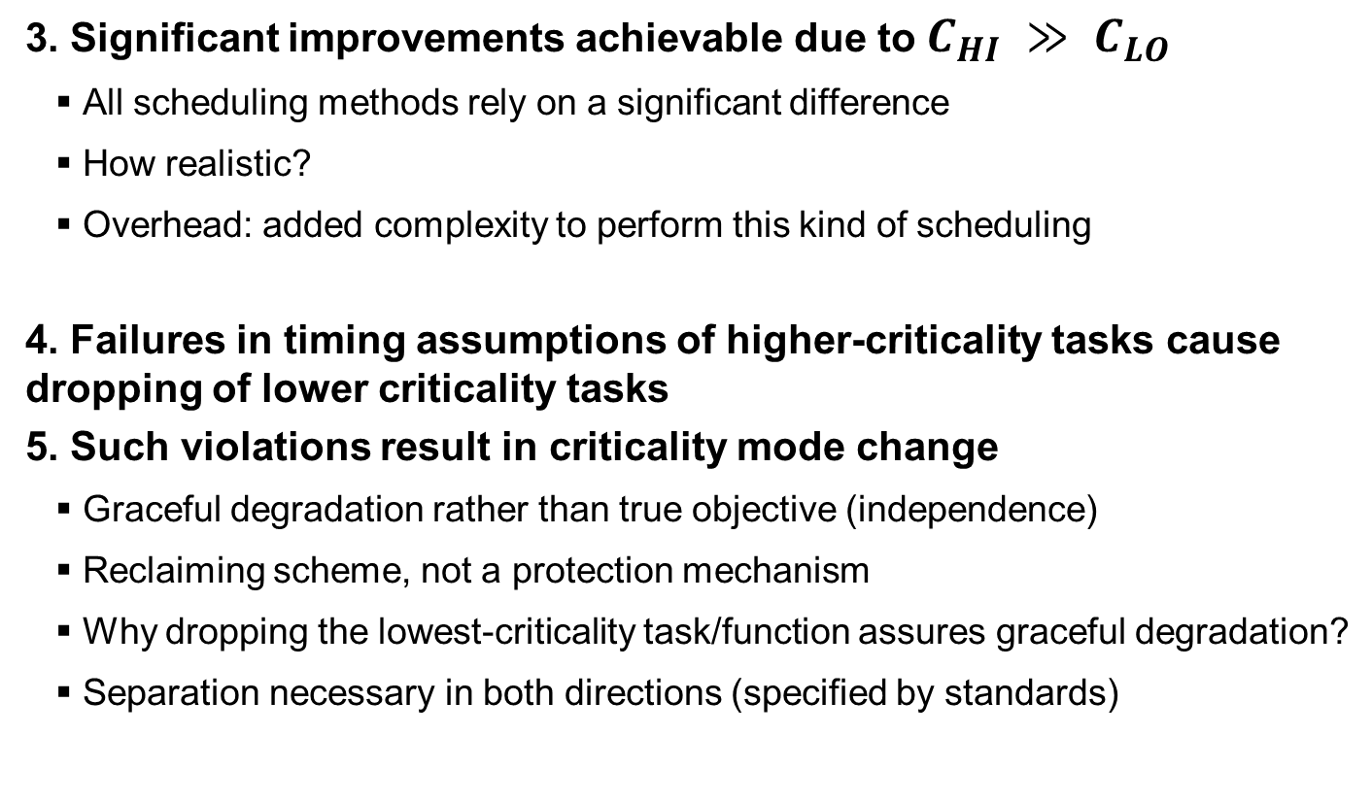
Fundamental assumptions and their limitations
3. Significant improvements achievable due to $C_{HI} ≫ C_{LO}$
All scheduling methods rely on a significant difference
How realistic?
Overhead: added complexity to perform this kind of scheduling
4. Failures in timing assumptions of higher-criticality tasks cause dropping of lower criticality tasks
5. Such violations result in criticality mode change
Graceful degradation rather than true objective (independence)
Reclaiming scheme, not a protection mechanism
Why dropping the lowest-criticality task/function assures graceful degradation?
Separation necessary in both directions (specified by standards)
Notes:
- Restoration of normal working mode justifiable in specific applications

Slide 31
ISO 26262 examples
Severity | Exposure | Controlability
 |  | C1 | C2 | C3
S1 | E1 | QM | QM | QM
 | E2 | QM | QM | QM
 | E3 | QM | QM | A
 | E4 | QM | A | B
S2 | E1 | QM | QM | QM
 | E2 | QM | QM | A
 | E3 | QM | A | B
 | E4 | A | B | C
S3 | E1 | QM | QM | A
 | E2 | QM | A | B
 | E3 | A | B | C
 | E4 | B | C | D
Dropping F1 might result in
consequences of higher severity
F2
F1
Notes:
- Criticality of function does not necessarily match the severity of the consequences, but a more complex process
- Which to drop and which to keep? How to prioritize among them?

Slide 32
ISO 26262 examples
Severity | Exposure | Controlability
 |  | C1 | C2 | C3
S1 | E1 | QM | QM | QM
 | E2 | QM | QM | QM
 | E3 | QM | QM | A
 | E4 | QM | A | B
S2 | E1 | QM | QM | QM
 | E2 | QM | QM | A
 | E3 | QM | A | B
 | E4 | A | B | C
S3 | E1 | QM | QM | A
 | E2 | QM | A | B
 | E3 | A | B | C
 | E4 | B | C | D
Dropping F1’ in favour of F2
reduces ASIL of F1
F1’
F2
F1*
F1
Notes:
- Dropping ASIL A in favour of ASIL B leaves the functionality to ASIL C only, meaning F1 is not ASIL D any more but ASIL C

Slide 33
Mitigation techniques
Priority reduction for low-criticality tasks
Deadline/period extension for low-criticality tasks
Computation time reduction for low-criticality tasks
Hardly acceptable in practice
Periods and priorities are functional requirements
Multiple computation times require multiple different implementations

Slide 34
Outline
Introduction to Mixed Criticality Systems
Safety standards
Industrial view
Academic view
Challenges

Slide 35
Challenges and open topics
Models for specification to guide the integration and verify adherence to standards
Tools to automate the verification of sufficient independence among different criticality levels (time = money)
AUTOSAR framework likely to dominate: needed extensions for specifications, requirements, constraints
Efficient sharing mechanisms (both HW and SW)
Dynamic time and space isolation mechanisms (rather than time-triggered)
Error systematisation (provide protection against common error types, compare trade-offs of addressing less common ones)
Notes:
Dynamic mechanisms are also more performant (efficient) which is necessary for safety-critical applications with high-performance requirements

Slide 36
Challenges and open topics
Mono-technological solutions
Open-world policy
Temperature and aging effects
Security aspects

Slide 37

Conclusions
Emerging mixed criticality systems with both safety-critical and high-performance requirements
Existing academic models do not meet industry (and standard) requirements
Different approaches and cooperation with industry necessary

Slide 38

Thank you

